Slide 1
Catering Reservation and Ordering System
Adhiyamaan college of engineering
DHANU SHRI . J

Slide 2
Abstract
Catering management is a database-based utility system designed to magnet information from one central database. The web application, containing the menu details, is used by the customer. The customer application and the admin application directly connect with each other through the same database. This application is user-friendly, efficient for caterers by saving time, and reduces human errors with customer feedback. In these modern times, reservation orders are still managed manually on papers, which are time-consuming and inefficient in that it results in incorrect recordings of reservations and is really difficult to generate a report so the manager can see the sales for the month. The objective of the project is to provide an accurate, quick, and highly effective catering reservation system that computerizes the manual method of managing reservations for implementation on the website online catering reservation system.

Slide 3
OBEJECTIVES
To provide a digital marketplace for rural town developers to showcase and sell their catering products.
It will enable rural towns to reach a global customer base and expand their market reach.
Facilitate seamless transactions between buyers and sellers, ensuring a user-friendly experience.
Promote local and sustainable catering practices from rural communities.

Slide 4
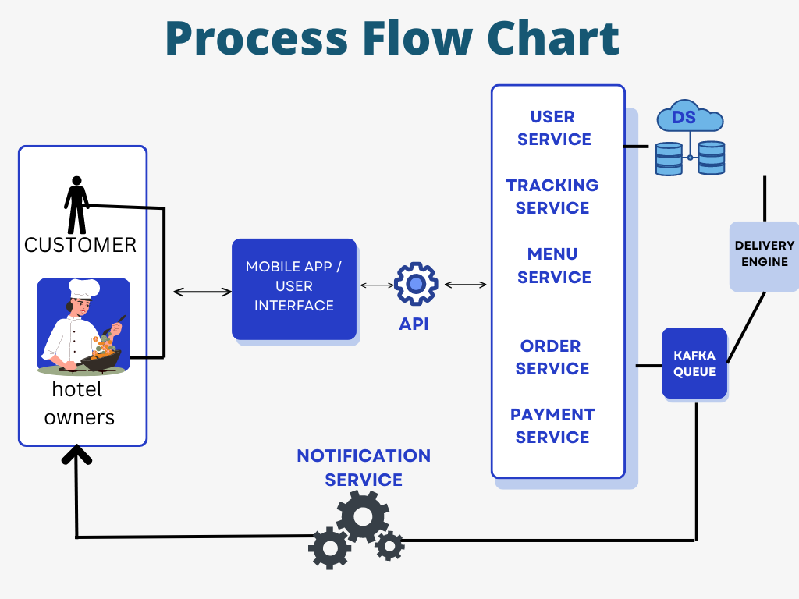
ARCHITECTURE

Slide 5
Features:
Vendor Profiles: Rural town developers can create profiles showcasing their catering products, specialties, and pricing.
Product Listings: Vendors can list their catering offerings with detailed descriptions, images, and prices.
Global Reach: The platform enables rural towns to access a global customer base and expand their market beyond local boundaries.
Secure Transactions: Secure payment gateways and transaction processing to ensure a safe and reliable purchasing experience.
Review and Rating System: Customers can provide feedback and ratings for catering services, promoting transparency and quality assurance.
Promotional Tools: Marketing tools to help vendors promote their products and reach a wider audience.

Slide 6
Implementation plan:
Platform Development: Design and develop the Catering website with user-friendly interfaces for vendors and customers.
Vendor On boarding: Invite rural town developers to register as vendors and create their profiles on the platform.
Marketing & Promotion: Launch marketing campaigns to attract customers and promote the unique catering offerings from rural towns.
User Training: Provide training and support to vendors on how to effectively use the platform and maximize their sales potential.
Feedback and Iteration: Gather feedback from users to continuously improve the platform and enhance user experience.

Slide 7
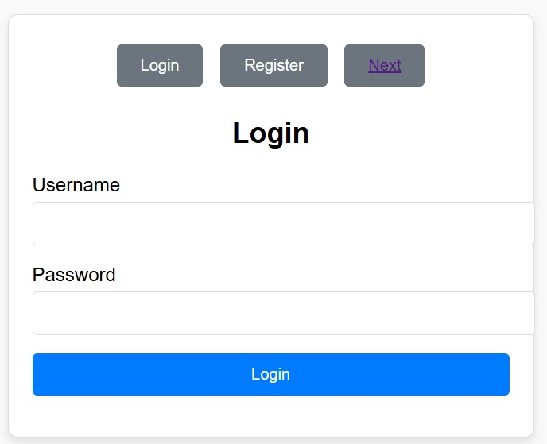
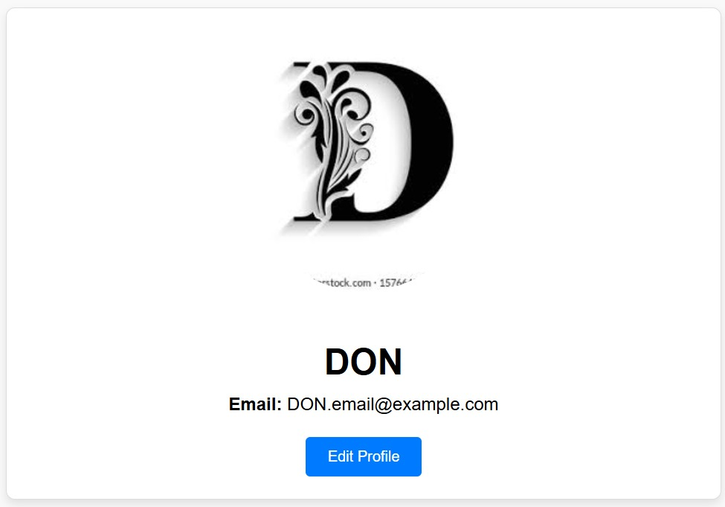
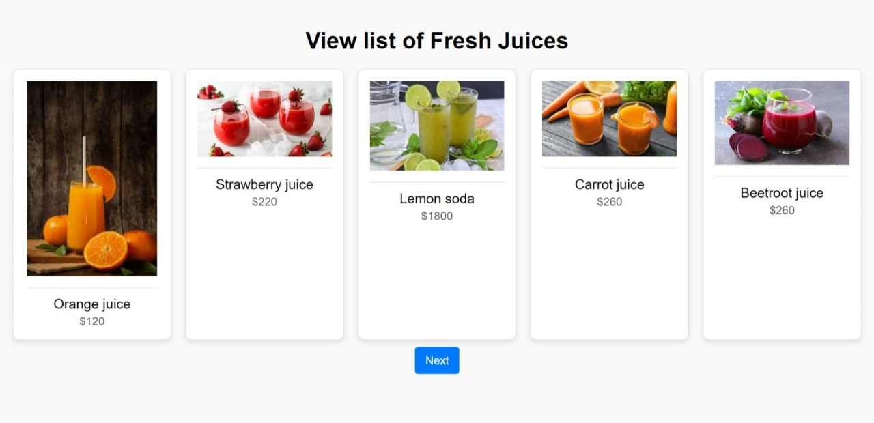
1.
2.
3.

Slide 8
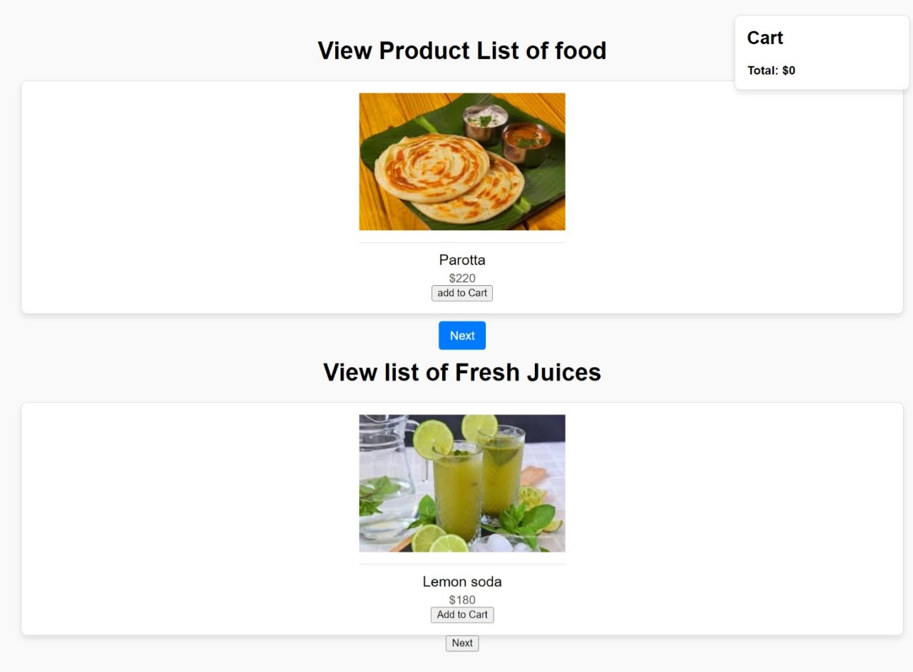
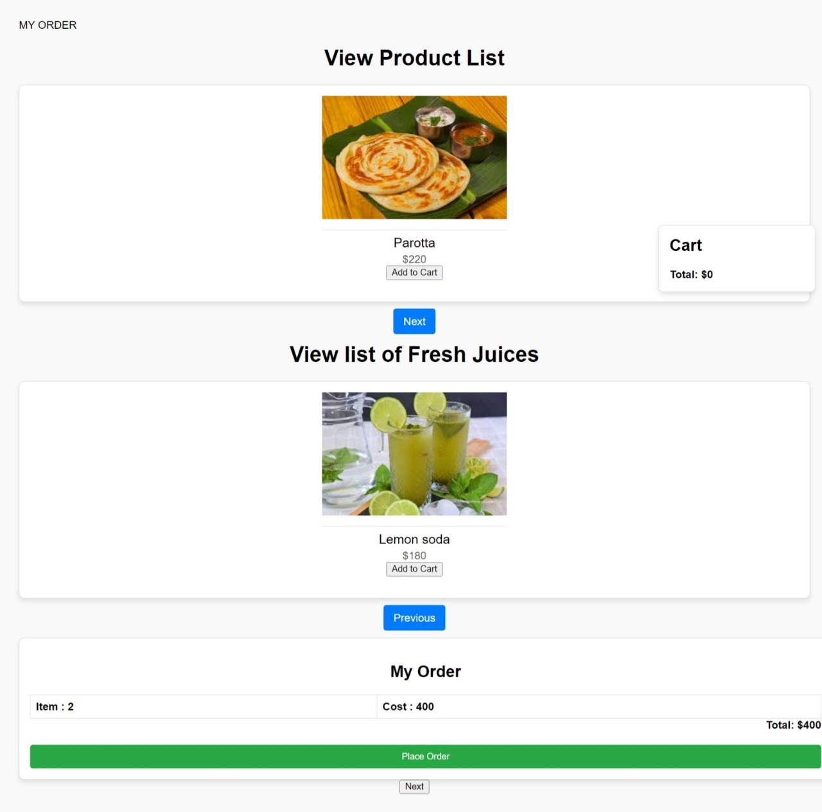
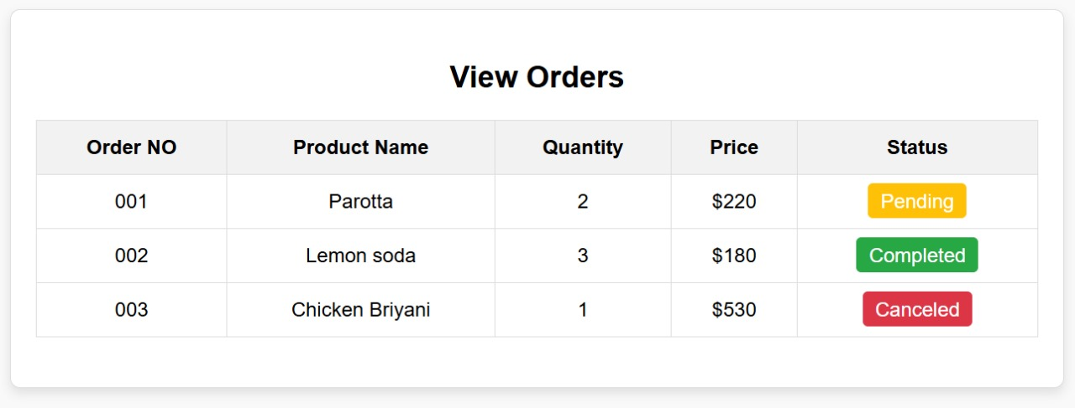
4.
5.
6.

Slide 9
Conclusion :
The Catering website serves as a bridge between rural town developers and a global market, enabling them to showcase their catering specialties and reach a wider audience. By empowering rural communities to promote their commodities, the platform contributes to economic growth and sustainability in rural areas.
This project report outlines the vision, objectives, features, and implementation plan for the Catering website, highlighting its potential to revolutionize the way rural towns sell their catering products on a global scale.

